Slide 1

YouTube Songs Analysis (With Power BI)
Submitted By:
OM Prakash Sahoo
E Mail Id : omprakashsahoo280@gmail.com
Internship Details:
Mentorness Internship Program, Batch MIP-DA-10

Slide 2
Dataset Overview:
Description: The dataset contains multiple attributes related to YouTube songs, including view, like, and comment counts. Key Features: Explain each feature in the dataset, highlighting its importance for the analysis.

Slide 3
Introduction:
Overview: This project uses Power BI to analyze YouTube song data to uncover trends in viewer engagement and song popularity. Objectives: The main goals are to explore the data, create insightful visualizations, and develop a dashboard to present the analysis.

Slide 4
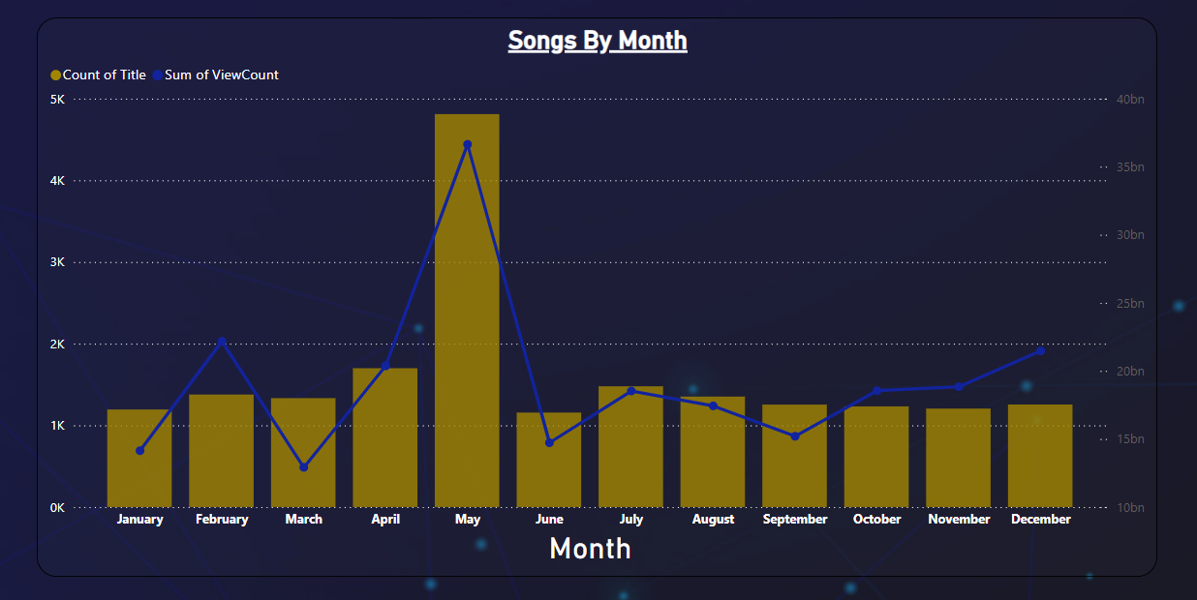
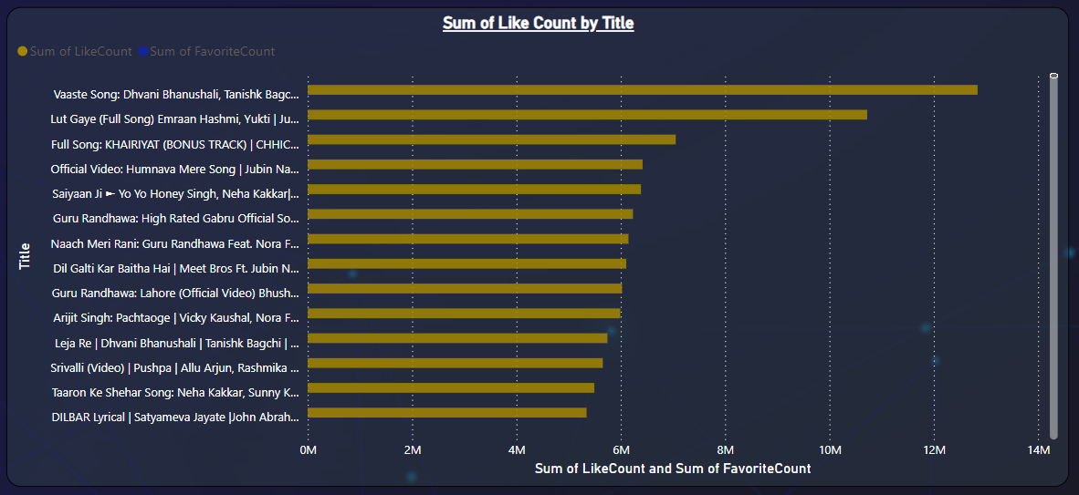
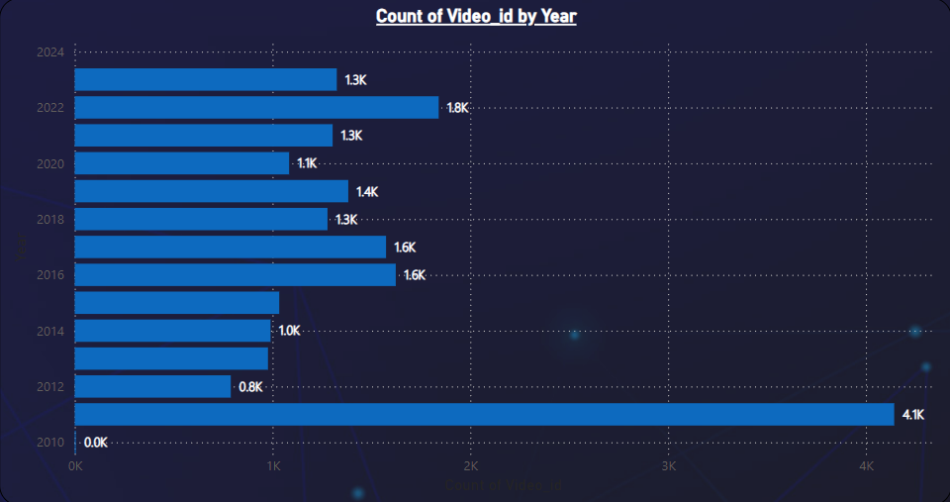
Exploratory Data Analysis (EDA):
View Count Distribution: Creating a histogram to understand the spread of view counts. Like Count vs View Count: A scatter plot to identify the relationship between views and likes. Comment Count Analysis: Bar chart to highlight the most commented songs.

Slide 5
Dashboard Overview :
Total Metrics: Card visuals displaying the sum of views, likes, and comments. Top Songs by Views: A bar chart showing the songs with the highest view counts. Engagement Metrics Over Time: Line chart to observe how likes and comments change over time. Duration vs Engagement: Scatter plot comparing the duration of songs with their engagement metrics to see if longer songs receive more likes/comments.

Slide 6
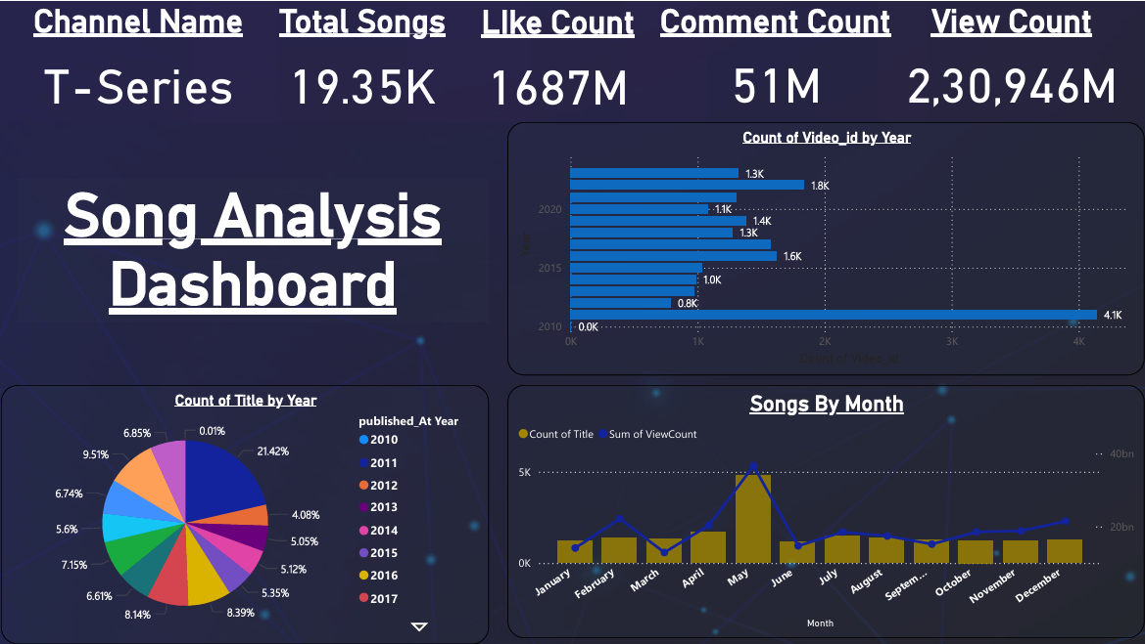

Slide 7
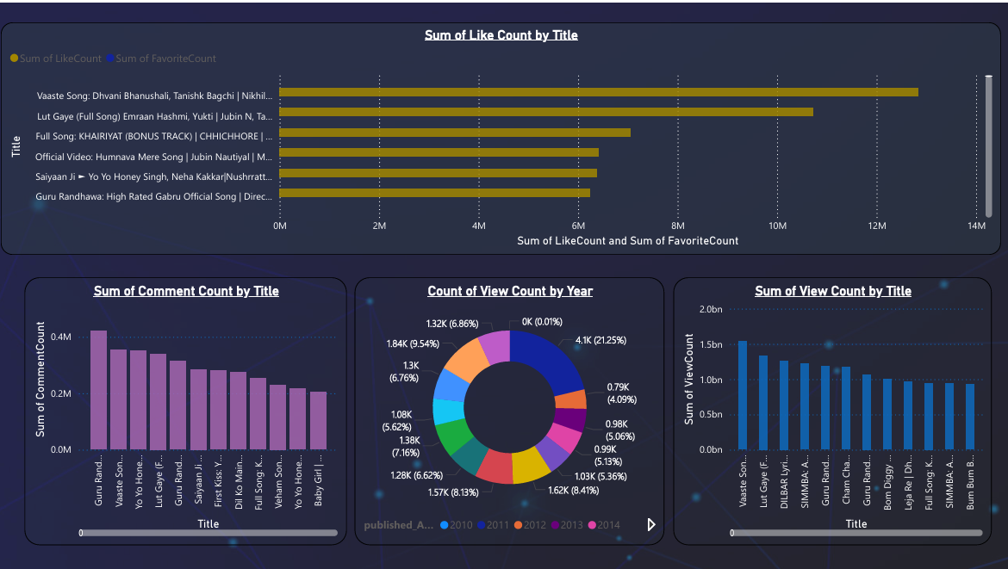

Slide 8
Conclusion:
Key Findings: Summarize the main insights from the analysis. Implications: Discuss the potential applications of these findings for content creators and marketers. Future Work: Suggest areas for further analysis, such as adding more recent data or exploring additional factors.

Slide 9
Thank
You

